Slide 1

Updating Your Member Profile
www.dkg.org

Slide 2
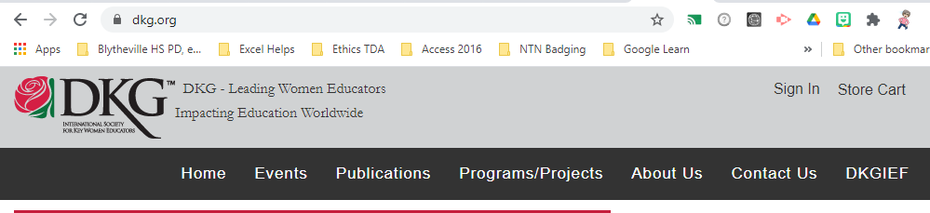
Navigate to www.dkg.org

Slide 3
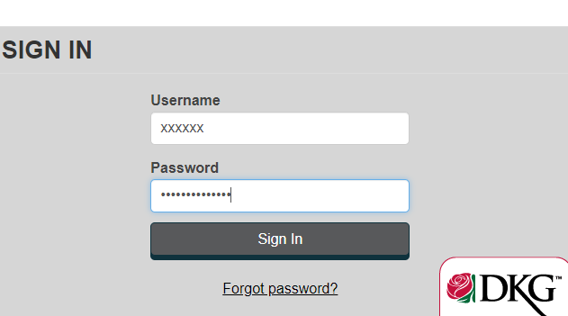
Username is your member number
Password is dkg2014society

Slide 4

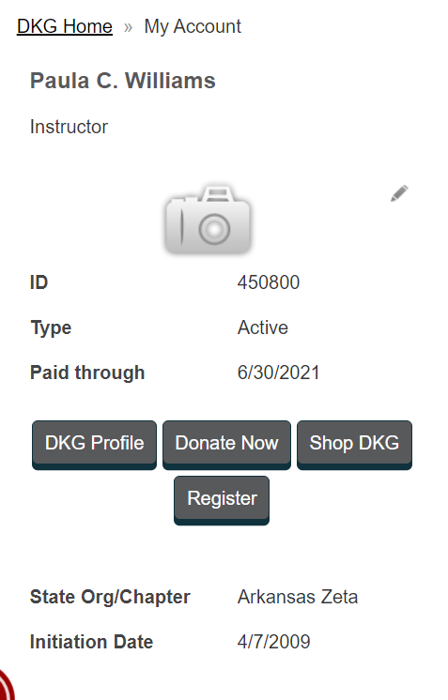
Click your Name

Slide 5
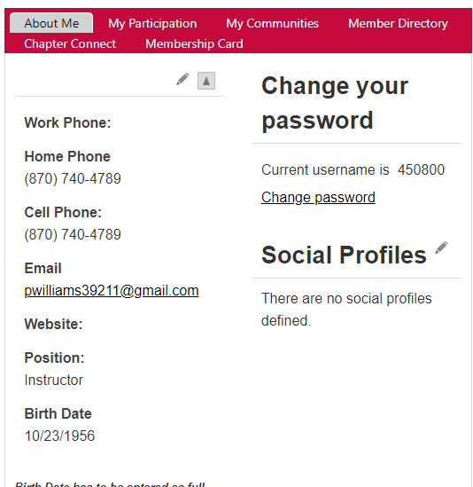
Edit your profile

Slide 6
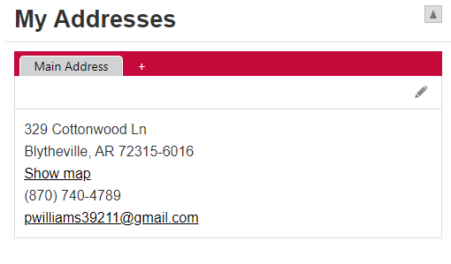
Addresses

Slide 7
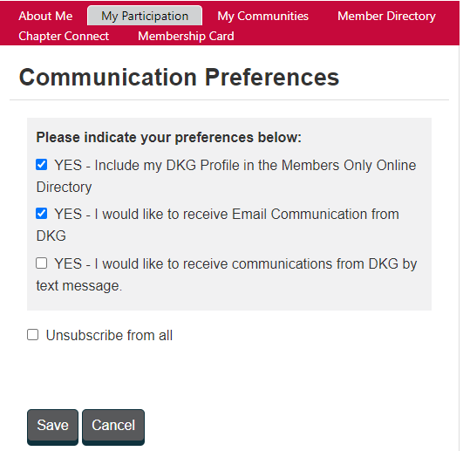
Communication Preferences

Slide 8
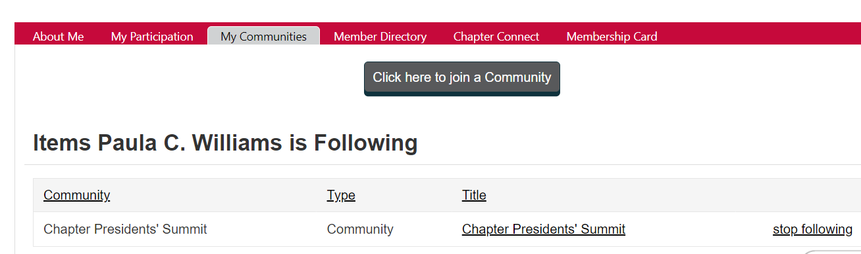
My Communities

Slide 9
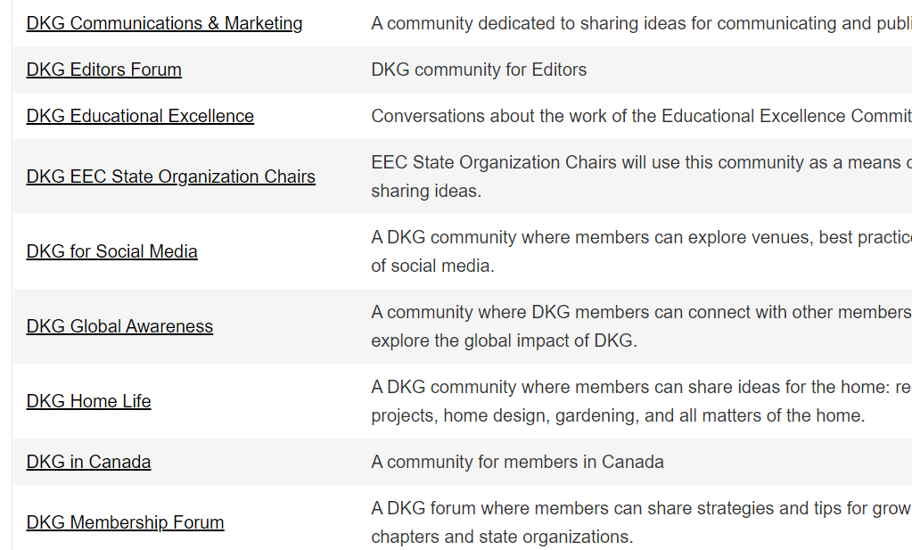
Find a Community

Slide 10
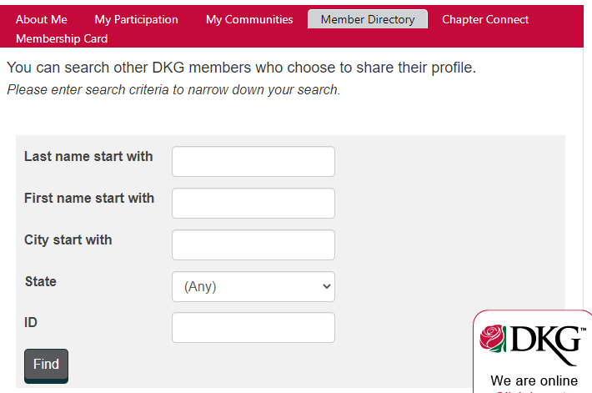
Membership Directory

Slide 11
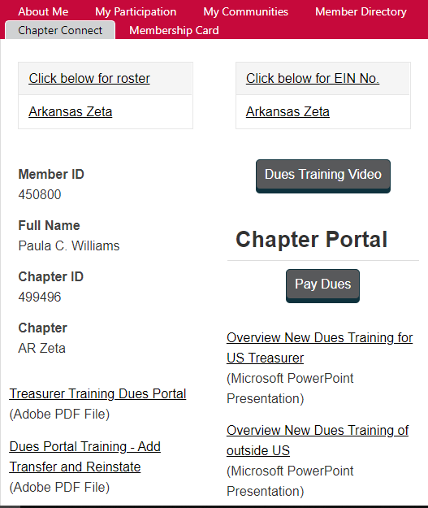
Chapter Connect

Slide 12
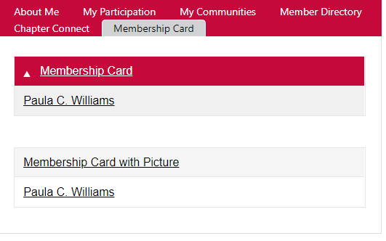
Membership Card

Slide 13
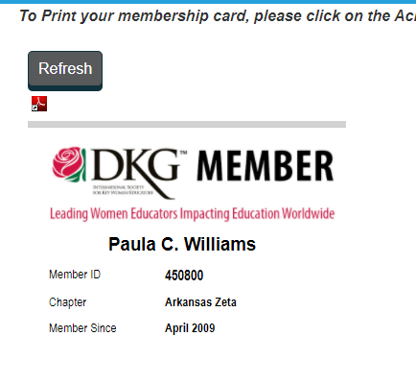
Membership Cards are electronic

