Slide 1
DKG Top 10 Chapter Strategies for a Post-Pandemic World
Dr. Debbie LeBlanc, Northeast Regional Director, Illinois

Slide 2
Caring and Nurturing Members
Notes:
Members are always a priority in DKG.

Slide 3
Ideas and Inspirations for COVID & Post-COVID Chapter Engagement
Notes:
Invite members of the state organization you are visiting to consider what happens beyond COVID
what will your chapters look like after covid?
what will you take to move forward?
how might our Society change?
How will we do things differently?
Here is our top 10 strategies for chapters….

Slide 4
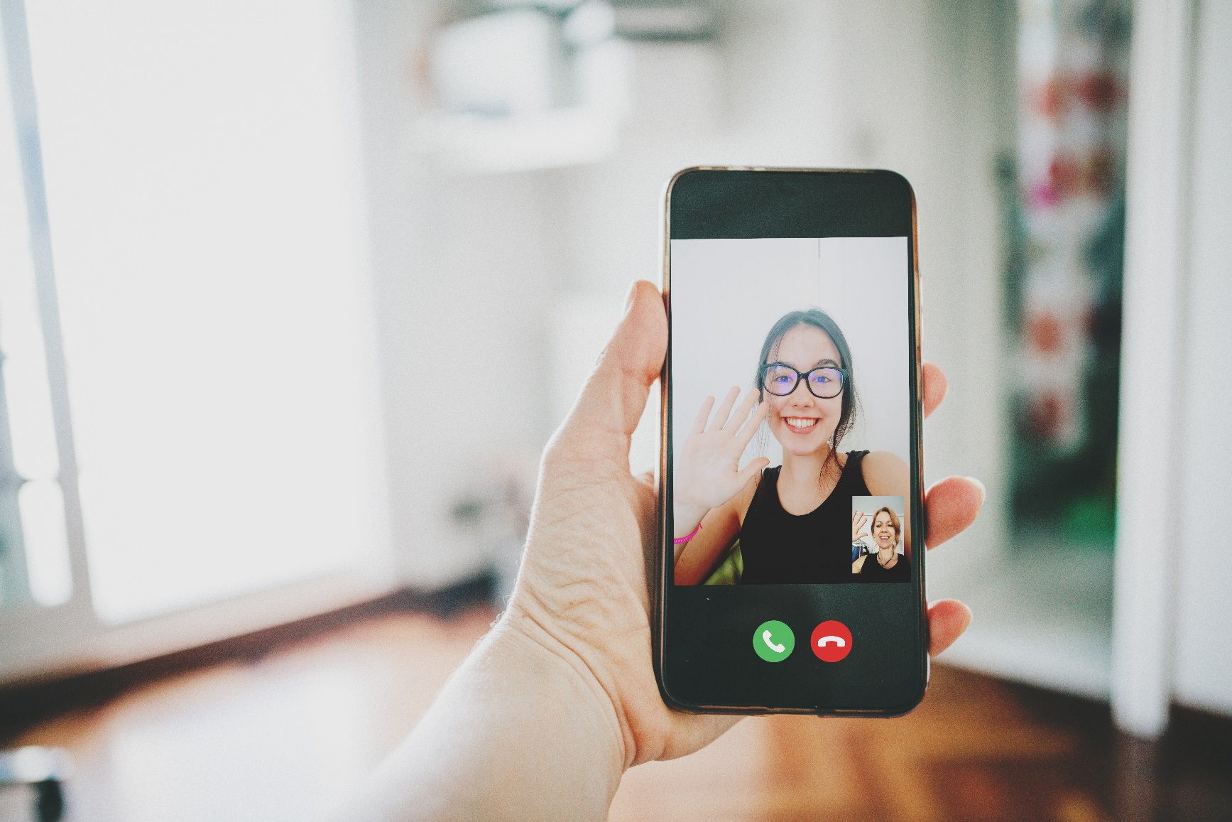
#10 Latin America Members Connect via Whats App
Notes:
How has your communication changed during the pandemic (AB member share a positive personal anecdote about attending a virtual chapter meeting of your own).

Slide 5
#9 Value Your Members!
Stay connected and keep getting to know one another.
Notes:
Saskatchewan state organization is profiling three members each month, here’s an example, their chapter vice-president, Brooke Alexander (Brooke has also adopted e-vites to send members reminders of upcoming meetings throughout the pandemic).
Stay connected and keep getting to know one another.

Slide 6
#8 Get Out of the Program Rut! Celebrate Member Success!
Notes:
Tips for engaging potential new members. Get off your zoom couch and connect with potential new members.
Invite a dynamic teacher from your local area to present to your chapter about what she is doing in her teaching during covid. (After the meeting, invite her to the next one as a guest).
Don’t forget the talents of your members. Let them do a program.

Slide 7
#7 Revitalization
Notes:
“talking about the importance of revitalization” generous entry point into the conversation.
Zoom meetings allow you to gather from throughout the state to talk about what is most meaningful to your state org chapter.
There are no excuses not to address revitalization.

Slide 8
#6 Make WELLNESS a Focus in Your Post-COVID Chapter Plans
Walk Daily
Build up your step count!
Notes:
Illinois State Organization has used Covid quarantining to address the personal well being of its members by selecting a different topic/activity for members to address monthly. Not a bad idea to continue post-Covid, too! Here is just a sampling of ideas to use:
Focus on each member drinking more water each day while decreasing the
intake of sugar in your diet.
Challenge each member to walk toward a goal of 10,000 steps daily by the end of the month.
Spend 30-60 minutes a day reading or listening to an audio book.
Clear the clutter by cleaning out a drawer or cabinet area each day.
Additional topics you might share include:
Writing Challenge: Set goals to write a little bit each day...journaling, creative writing, etc.
Giving Challenge: Send a small gift, care package or a card to a friend
Reducing Screen Time Challenge: Set a time each day to move away from your device and spend time with a friend, neighbor, or relative
New Skill Challenge: Start fresh by making an effort to learn a new skill
What ideas could you add to this list as challenges to undertake for you and chapter members?

Slide 9
#5 Connect with International Committee Members
Explore:
Chapter Plans
Roles
Tasks
International vs. State Organization
Selection process
Ways to strengthen connections
Notes:
#5 Connect with International Committee Members in Your Post-COVID State Organization/Chapter Plans
Connect with international committee members in your region to learn about:
The role of an international committee member
Tasks addressed on an international committee
Differences between an international committee member and SO or chapter committee members
The selection process for international committee members
Strengthening the bond between SO and international? ...between chapters and international?
The Europe Region under the guidance of Margarita Hanschmidt, Europe Regional Director 2020-2022, is promoting a better understanding between Europe members and the international level of DKG through work with international committee members from her region. These committee members are Zooming with state organization leaders to share their experiences and to facilitate better understanding about their work. It’s an idea that has merit for state organizations and chapters throughout DKG.
Hanschmidt has set four goals for her project with international committee members:
To stay more loosely connected
To foster a greater understanding of diversity
To share best practices on the Europe webpage for all members in the region to access
To grow members
How could you take this idea and use it in your state organization with your chapter
leaders? How could you use this idea across your region?

Slide 10
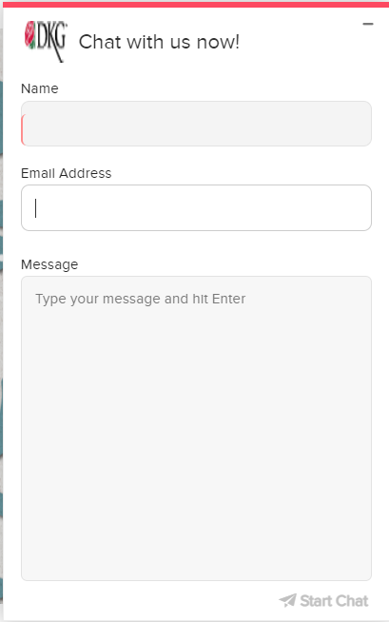
#4 Every Member is a Connected Member
Notes:
Promote the HQ chat (promoting website by extension)
Slide notes:
Promote connecting with HQ via the online, live chat feature.
This is not a “bot” but is staffed by our amazing HQ personnel
Tip for AB rep: if you present at a time when HQ is open, pre-arrange a chat so you can go “live” during your workshop. If not open, share an anecdote of how you have used the chat.
4548 chats answered in 2020. A few frequently asked questions:
Requests for assistance with My DKG account (locked out or how to log in)
How to find Chapter Connect
How to run rosters (chapter officers in Chapter Connect)

Slide 11
#3 Technology
Notes:
is part of our post-pandemic future Meeting formats — now that we have learned this, let's move forward, not back. Continued use of technology.
Some Chapters are doing the following:
Chapters assist early career educators through many variations of the SEE program – from providing moral and financial support to hands-on support via mentoring, assisting with classroom set up or helping with lesson plans
Some chapters are very involved with women’s programs that address domestic abuse, assist with career development and work skills, provide career resources such as clothes and supplies, and support children’s programs and centers
Many chapters are informally reporting that use of Zoom and other technology has increased meeting participation. However, these projects have traditionally been “in person” so they are struggling to find ways to continue with them in 2020-2021.
A ps, 2020 “online event” speakers and workshops are still available through June 2021.

Slide 12
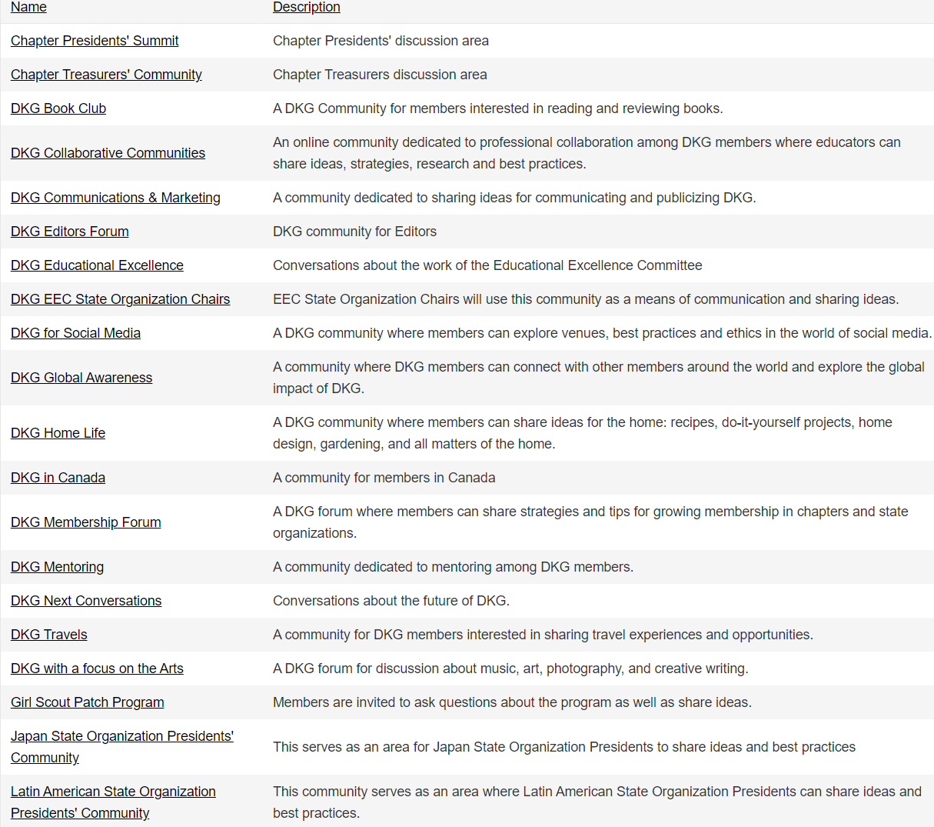
#2 Teacher Resources for a Post-Pandemic World
Notes:
Highlight 3-5 resources that could be helpful/interesting to teachers and members during this time and indicate how these resources and others can make up an upcoming chapter program.
Here are a few examples:
DKG Fine Arts Gallery
DKG Communities
DKG Social Media Posts (Pinterest, Facebook, Linked In)
CTAUN
Collegial Exchange Magazine
(Virtual tours of Arts and community resources (Lace)
#EdTech Endeavours -- a podcast channel with e-school teacher Amanda Brace. https://edtechendeavours.com/

Slide 13
#1 ZOOM Coffee Might Just be the New Starbucks!
Notes:
Nita, a coffee graphic on a zoom background (or Teams or Google Meet, or all three)
what will YOUR chapters look like after COVID?
what will YOU do moving forward?
how WILL WE change OUR DKG?
How will WE do things differently?
Slide notes:
As we move forward, one thing hasn’t changed: Relationships and a sense of genuine spiritual fellowship tie DKG members together.
Maybe you will:
start up a challenge
Hold a technology mediated coffee party to promote chapter priorities
bring small groups of members together to network
Change committee meeting structures so that members with competing priorities can access AND contribute more easily
Presenter: share an anecdote of one amazing experience you’ve had IN DKG during the pandemic and connect it to a post-pandemic wish of something we will do to keep strengthening our DKG ties.

Slide 14
The DKG Society International
www.dkg.org
Notes:
Let’s stay connected!

